Slide 1
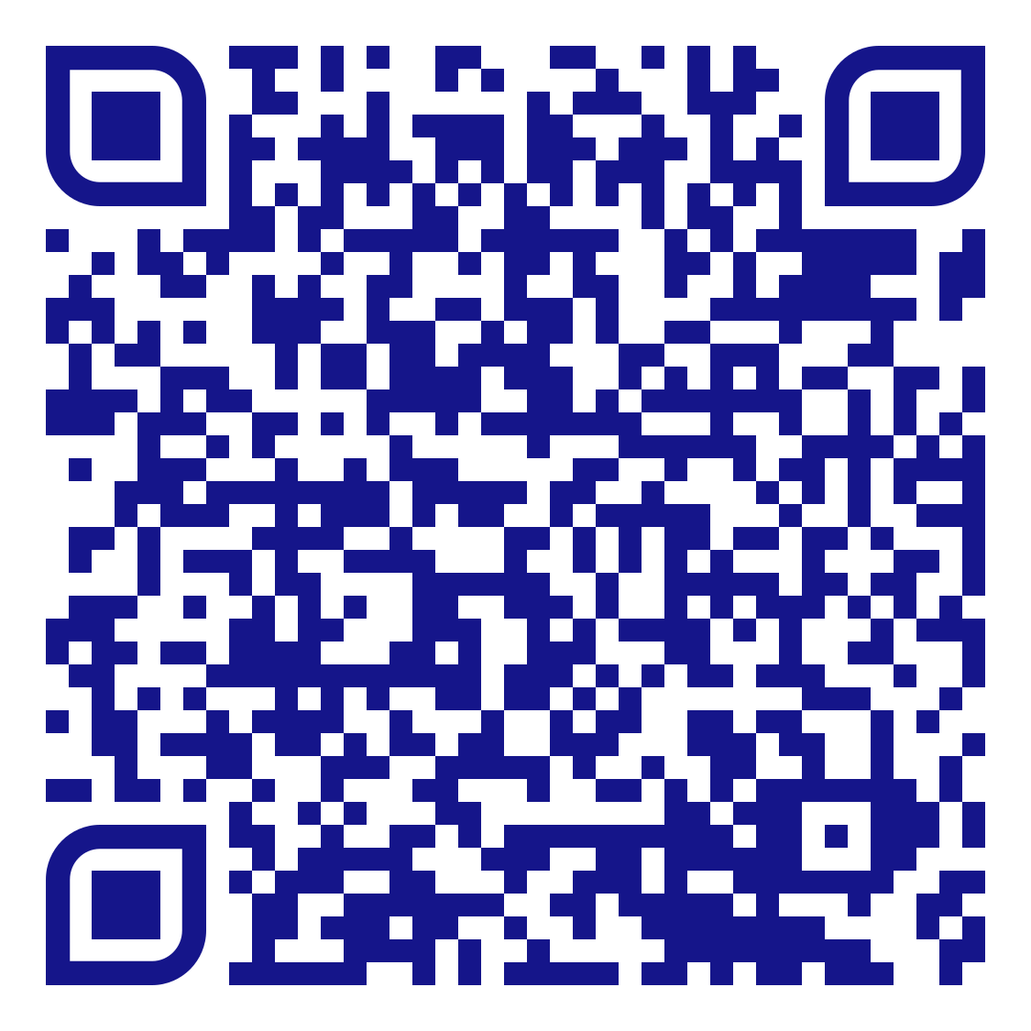
Take part in our Autumn term Expert panel on gender equality
We want to hear from you
Expert panel on gender equality
What do you think is important for gender equality?
What more can we do to promote gender equality in the department?
What more can we do to support students with caring responsibilities?
Where
  LMB/037X (ground floor, Law and Sociology Building) – tea, coffee, and cake will be provided.
When
  Wednesday 12th October, 2:30-3:30pm (UG students)
  Wednesday 12th October, 3:30-4:30pm (PGT and PGR students)
Why
  Share your thoughts/ideas/suggestions
  Hear about opportunities to promote gender equality in the department
Share your thoughts on the jamboard

